Slide 1
Global reach, or out of reach?
Exploring the relationship between a hegemon’s naval capabilities and state conflict behavior.

Slide 2
Research question
Does the naval capability of the hegemon impact the conflict behavior of other states in the international system.
Background
Modelski (1978): Cycles of hegemony through naval power
Mearsheimer (2003): No hegemony, naval power does not matter
Crisher (2017): Increases in naval power results in higher likelihood of militarized dispute

Slide 3
Gap
Does the naval capability of the hegemon affect the likelihood of conflicts in which it is not an initial party?
The issue of naval capabilities.
Operationalization
Endogeneity

Slide 4
Theory
States will take into consideration the ability of a hegemon to project power through naval capability and adjust their foreign policy behavior to avoid potential punishment by the hegemon. Specifically, states will engage in fewer conflicts when the hegemon’s ability to project power increases.
H1) Increased naval capability of the hegemon will decrease the likelihood of a militarized interstate dispute.
H2) Increased naval capability of the hegemon will decrease the likelihood of a militarized dispute involving some form of the use of force.

Slide 5
Methods
2 Logistic models will be tested in this paper
The occurrence of MIDs
The occurrence of MIDs which involve the use of force

Slide 6
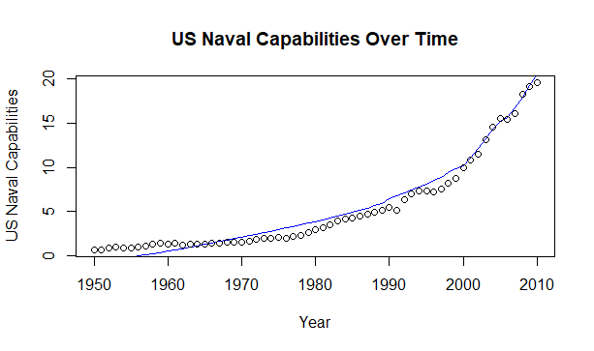
Variables
Dependent
Occurrence of a MID
Occurrence of a MID which involved the use of force
Independent
US naval capabilities
Controls
Relative capabilities of actors A and B
Similar region
Contiguity
Joint Democracy
Presence of at least 1 major power
Post Cold War dummy
Lagged variable for occurrence of a MID in past 2 years.
Naval Capability: [(Military expenditures / Military Personnel) X Proportion of global naval tonnage captured by the US.] / 10,000

Slide 7
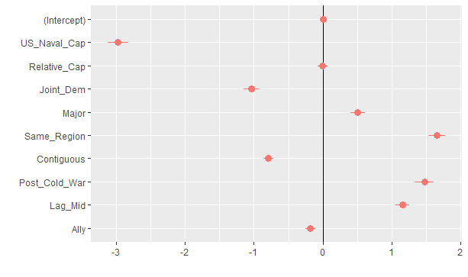
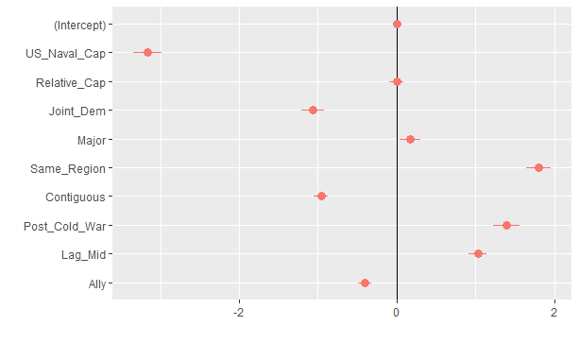
Results
In both logit models US naval capability has a statistically significant and negative relationship with the occurrence of a militarized dispute. All other variables with the exception of relative capabilities are also statistically significant. Joint democracy, contiguous borders, and an alliance have a negative relationship with MID and violent MID occurrence. The presence of a major power, a recent history of a MID, being in the same region, and the post Cold War dummy all exhibit a positive relationship with MID and violent MID occurrence.
MID Occurrence Log odds US naval capabilities = 0.74396 Use of force Log odds US naval capabilities= 0.73004

Slide 8
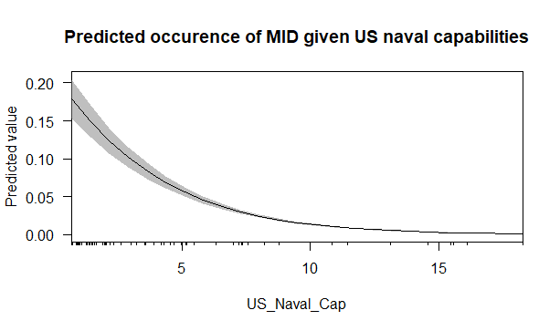
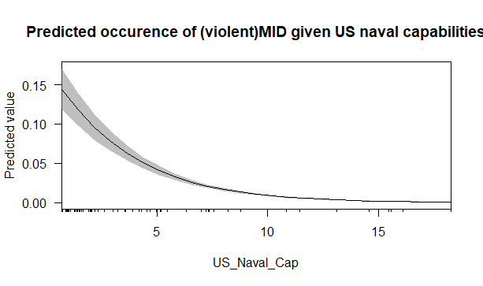
Results
Predicted probability plots of both dependent variables demonstrate lower predicted probabilities as US naval capabilities increase.

Slide 9
Conclusions
I have found support for my hypotheses that increased naval capability by the hegemon will result in a reduced likelihood that a militarized dispute will occur. I have also found evidence to support my hypothesis that increased naval capability of the hegemon will result in fewer MIDs that involve the actual use of force.

Slide 10
Potential for the future
Looking beyond US hegemony historically
Britain, Spain, United Provinces
Continually evolving measures for state/naval capability
New data and new techniques

